Slide 1
Reliable Security: Double Error Correction for AN Codes in Encryption Systems
Presenter: Yuan-Fu Liu
Professor: Tsung-Chu Huang

Slide 2
Outline
Introduction
Previous Work
Proposed Technique
Experimental Results
Conclusions and Future Work
Reference

Slide 3
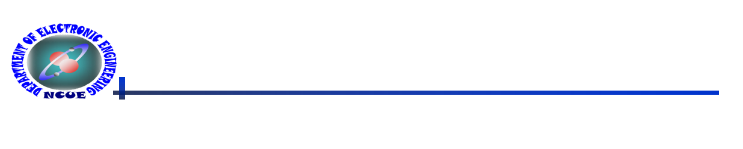
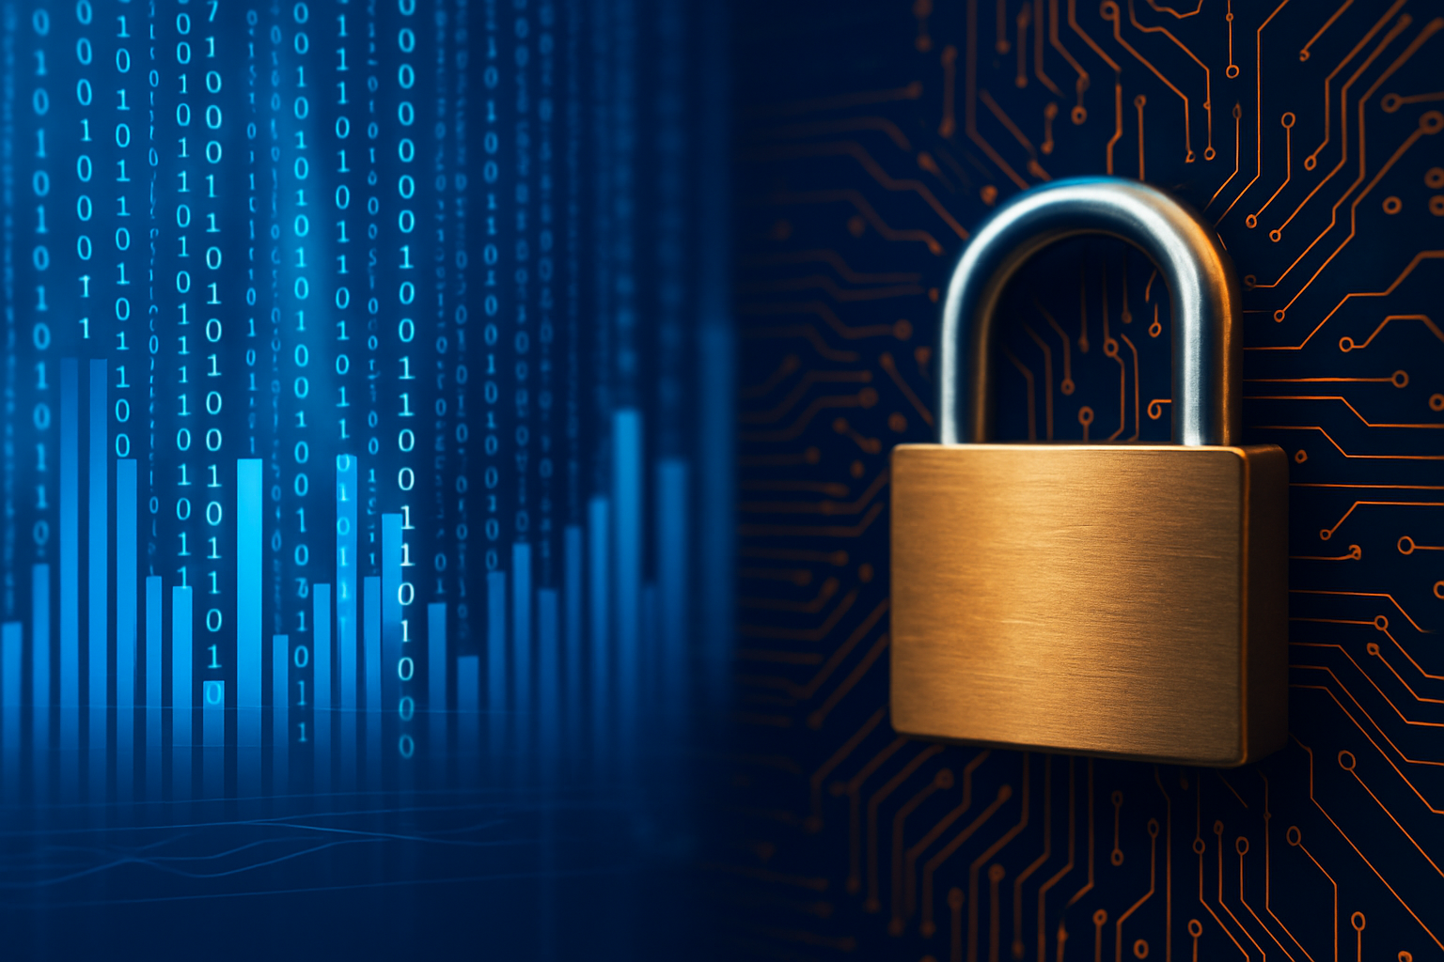
Introduction(1/3)
In this era of rapid hardware development, data processing workloads are growing exponentially.
Information confidentiality and security are becoming increasingly critical.
3

Slide 4
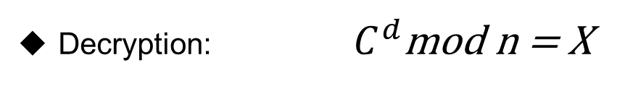
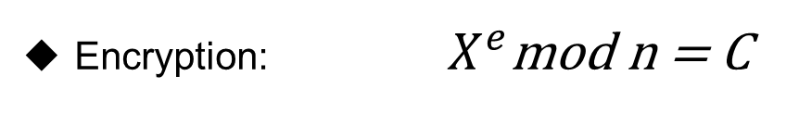
Introduction(2/3)
RSA, which process data (n) up to 2048 bits is necessary for secure communication
Errors will propagate through during encryption and decryption [1]
Encryption: $X^{e}$mod n = C
X: original message
C: encrypted message
n: the power of data
e: the power of public key
d: the power of private key
Decryption: $C^{d}$mod n = X
4
Electronic Engineering, National Changhua University of Education

Slide 5
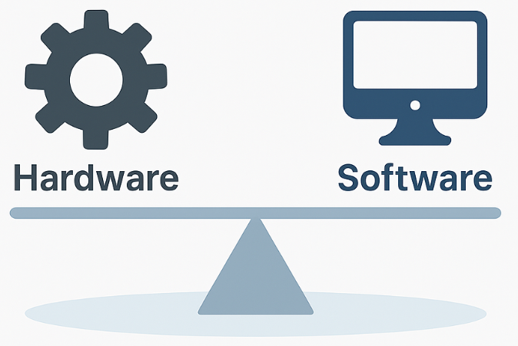
Introduction(3/3)
So far no analytical decoding or systematic approach for double error collection (DEC) has been explored.
We propose a method based on LUT (look-up table) to correct double AWEs in AN codes.
Besides LUT-based approach, a tradeoff method between hardware and software is feasible to reduced resource utilization.
5
Electronic Engineering, National Changhua University of Education

Slide 6
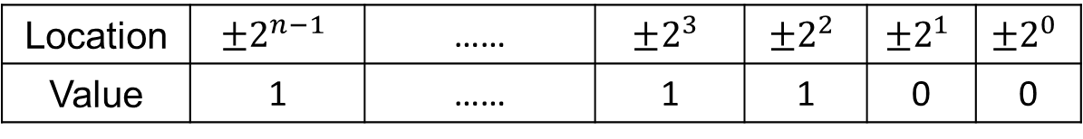
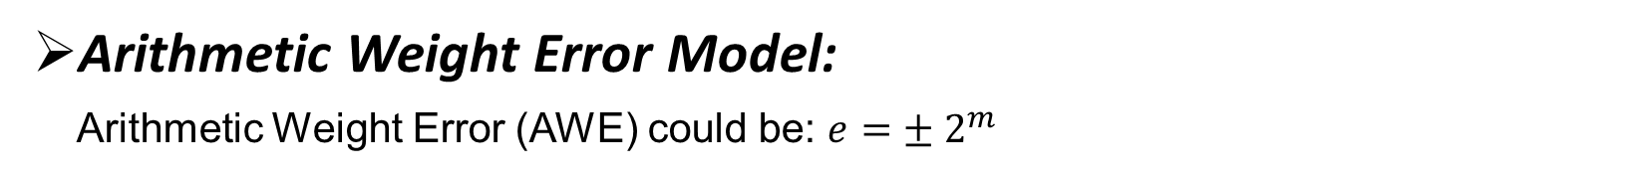
Previous Work(1/3)
Arithmetic Weight Error Model:
Arithmetic Weight Error (AWE) could be: $e=±{ 2}^{m}$
Location | $$±2^{n−1}$$ | …… | $$±2^{3}$$ | $$±2^{2}$$ | $$±2^{1}$$ | $$±2^{0}$$
Value | 1 | …… | 1 | 1 | 0 | 0
ex: 3(4’b0011) ➔ +2¹ AWE ➔ 5(4’b0101)
Bit Error Model: (channel)
0 ➔ 1 , 1 ➔ 0
ex: 3(4’b0011) ➔ bit error occur on second bit ➔ 1(4’b0001)
6
Electronic Engineering, National Changhua University of Education

Slide 7
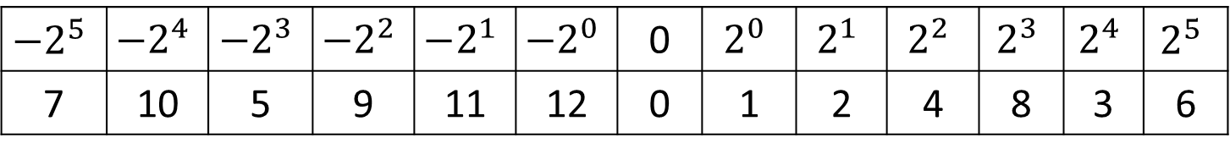
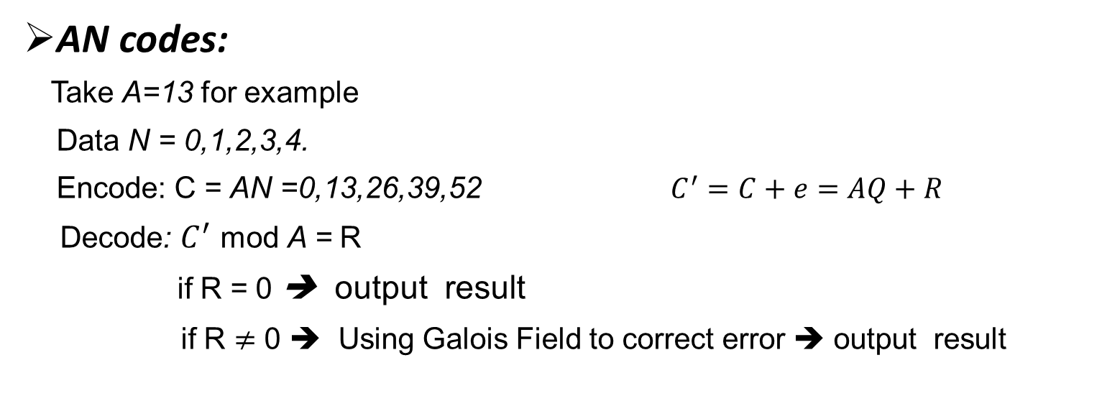
Previous Work(2/3)
AN codes:
Take A=13 for example
Data N = 0,1,2,3,4.
Encode: C = AN =0,13,26,39,52 $C^{′}=C+e=AQ+R$
Decode: $C^{′}$ mod A = R
if R = 0 ➔ output result
if R $≠$ 0 ➔ Using Galois Field to correct error ➔ output result
$${−2}^{5}$$ | $${−2}^{4}$$ | $${−2}^{3}$$ | $${−2}^{2}$$ | $$−2^{1}$$ | $$−2^{0}$$ | 0 | $$2^{0}$$ | $$2^{1}$$ | $$2^{2}$$ | $$2^{3}$$ | $$2^{4}$$ | $$2^{5}$$
7 | 10 | 5 | 9 | 11 | 12 | 0 | 1 | 2 | 4 | 8 | 3 | 6
Galois Field for A=13
7
Electronic Engineering, National Changhua University of Education

Slide 8
Previous Work(3/3)
A typical path with channel/memory and computations:
 | Not enable to detect and correct errors. | Enable to detect and correct errors.
Channel Codes | ①③④⑤⑥⑦⑧⑨⑩ | ②
AN (Product) Codes | ④⑤⑨⑩ | ①②③⑥⑦⑧
Channel Codes VS. AN Codes
8
Electronic Engineering, National Changhua University of Education

Slide 9
Proposed Technique(1/6)
Look-up Table (LUT) based on DEC:
Through the algorithm to find an A that can have distinct remainders.
9
Electronic Engineering, National Changhua University of Education

Slide 10
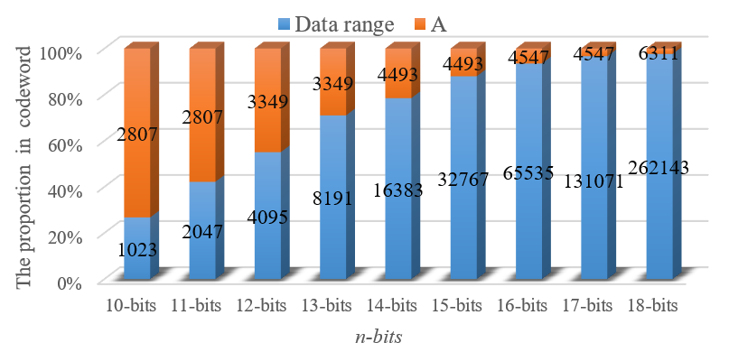
Proposed Technique(2/6)
The proportion of A in codeword:
Applying DEC to encryption technology that involve large-scale computations such as RSA is feasible.
10
Electronic Engineering, National Changhua University of Education

Slide 11
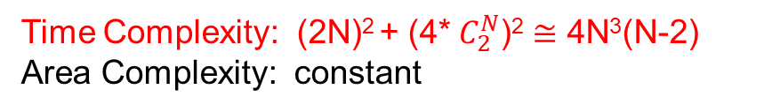
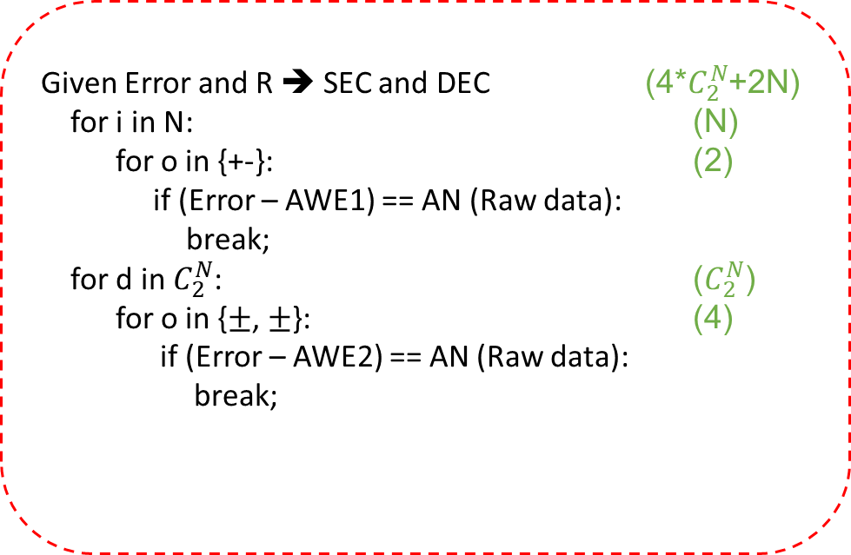
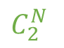
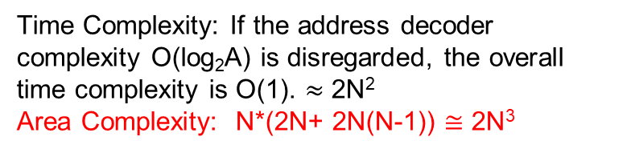
Proposed Technique(3/6)
Parallel: LUT vs. Sequential: Fully Search
$$C_{2}^{N}$$
Given Error and R ➔ SEC and DEC (4*$C_{2}^{N}$+2N)
for i in N: (N)
for o in {+-}: (2)
if (Error – AWE1) == AN (Raw data):
break;
for d in $C_{2}^{N}$: ($C_{2}^{N}$)
for o in {$±$, $±$}: (4)
if (Error – AWE2) == AN (Raw data):
break;
………………......
DEC: 2N(N-1)
Address
Decoder
R
(+/-) *(+/-):4
0, 1, 2, ..., A-1
SEC: 2N
N
+/-:2
Time Complexity: If the address decoder complexity O(log₂A) is disregarded, the overall time complexity is O(1). $≈$ 2N²
Area Complexity: N*(2N+ 2N(N-1)) $≅$ 2N³
Time Complexity: (2N)² + (4* $C_{2}^{N}$)² $≅$ 4N³(N-2)
Area Complexity: constant
11
Electronic Engineering, National Changhua University of Education

Slide 12

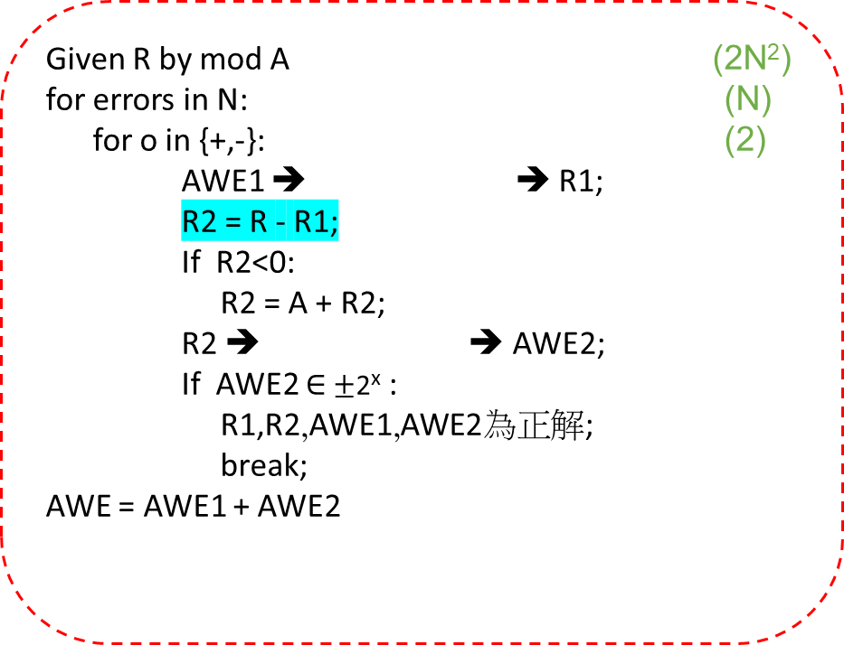
Proposed Technique(4/6)
A Trade-off Method For DEC
Using linear decomposition, a Double-AWE remainder can be split into two single-AWE remainders, reducing LUT complexity. However, software-based searching is still required to complete the correction.
Given R by mod A (2N²)
for errors in N: (N)
for o in {+,-}: (2) AWE1 ➔ ➔ R1;
R2 = R - R1;
If R2<0:
R2 = A + R2;
R2 ➔ ➔ AWE2;
If AWE2 $∈$ $±$2^{x} :
R1,R2,AWE1,AWE2為正解;
break;
AWE = AWE1 + AWE2
………………………………....
N
Address
Decoder
R
SEC: 2N
+/-:2
Time Complexity: 4N³
Area Complexity: 2N²
0, 1, 2, ..., A-1
12
Electronic Engineering, National Changhua University of Education

Slide 13
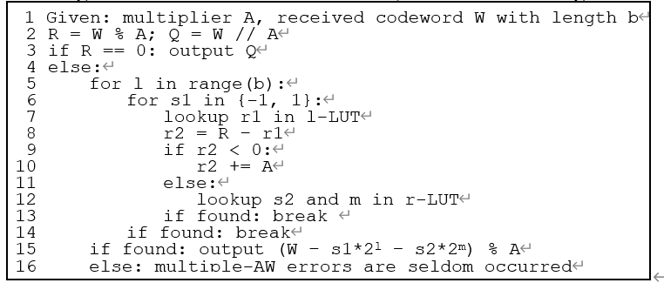
Proposed Technique(5/6)
A Trade-off algorithm For DEC
13
Electronic Engineering, National Changhua University of Education

Slide 14
Proposed Technique(6/6)
Automatic Synthesizer:
Building on the Trade-off method, a Python-based synthesizer was developed to generate LUT for different AWE’s location. This synthesizer converts the LUT from a .py (python) file into a .v (Verilog) file
14
Electronic Engineering, National Changhua University of Education

Slide 15
Experimental Results(1/11)
BLER(BLock Error Rate) in channel:
AWGN: Add Gaussian white noise
Lead to bit reversal
Generate random numbers to serve as data.
data*A
convert to binary
Add Gaussian white noise (AWGN)
Output result
Receive data and convert to decimal
R = 0
decimal
data mod A
Using decoder
To correct errors
R != 0
Output result
15

Slide 16
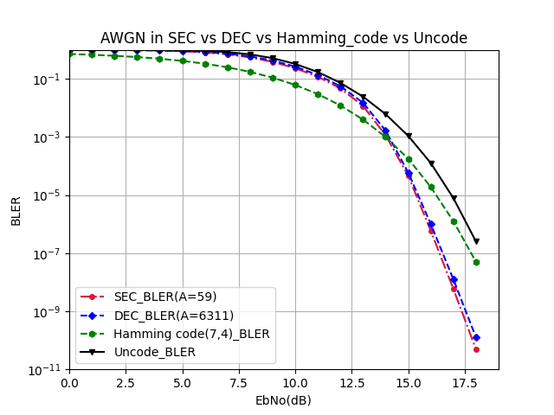
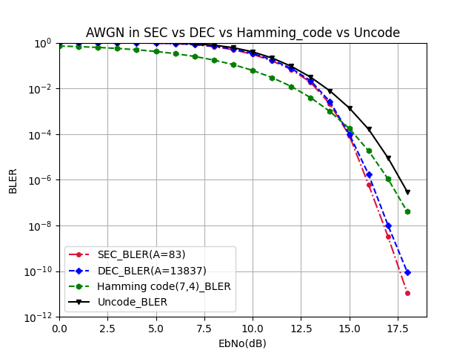
Experimental Results(2/11)
Data: 18 bits
Data: 26 bits
(BLock Error Rate)
SNR
Due to the larger A value in DEC, the number of bits after encoding (*A) increases, leading to error propagation during channel transmission. As a result, the error correction performance of DEC and SEC in the channel shows little difference.
16

Slide 17
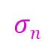
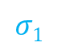
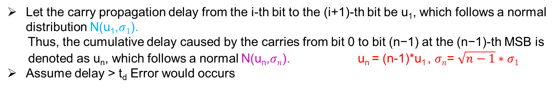
Experimental Results(3/11)
AWE Rate about carry:
Let the carry propagation delay from the i-th bit to the (i+1)-th bit be u₁​, which follows a normal distribution N(u₁,$σ1$).
Thus, the cumulative delay caused by the carries from bit 0 to bit (n−1) at the (n−1)-th MSB is
denoted as u_{n}, which follows a normal N(u_{n},$σn$). u_{n} = (n-1)*u₁ , $σn$= $\sqrt{n−1}∗σ1$
Assume delay > t_{d} Error would occurs
data arrival time
clock
period
c (counts)
$$σ1$$
$$σn$$
MSB’s error counts
LSB’s error counts
u_{n}
t_{d}
t (Delay time)
17
u₁

Slide 18
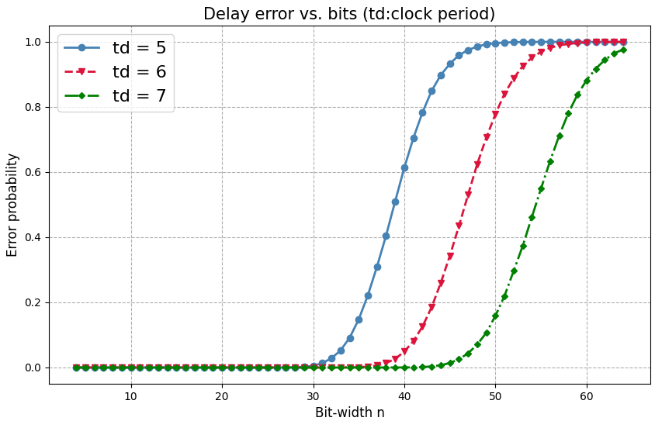
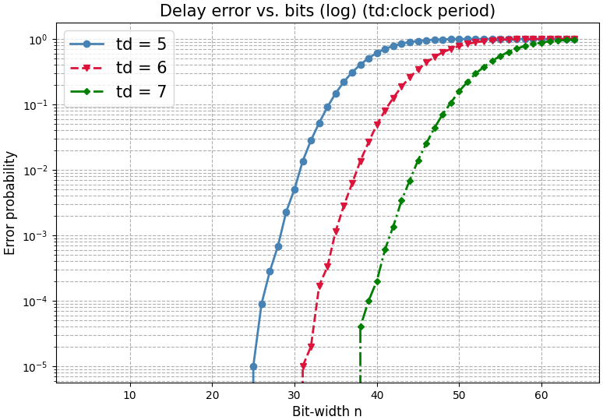
Experimental Results(4/11)
AWE Rate : Adder
18

Slide 19
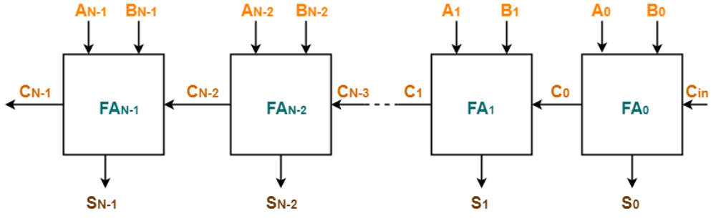
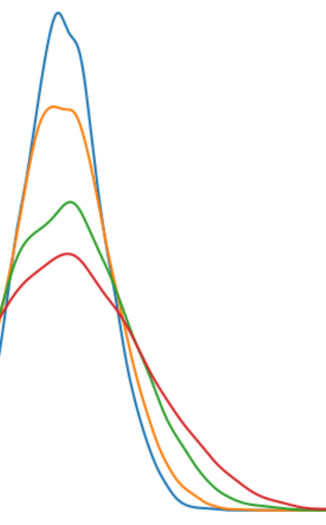
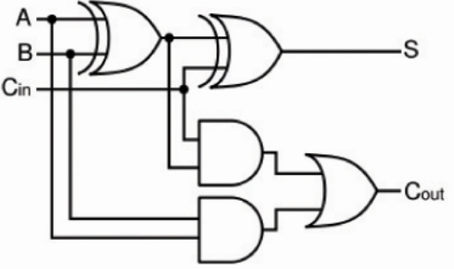
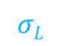
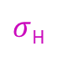
Experimental Results(5/11)
S[n-1:0]
A[n-1:0]
The introduction of noise results in delay exhibiting a distribution with a standard deviation correlated to the noise intensity.
n-bits
Adder
B[n-1:0]
C_{n-1}
Cin
c (counts)
.........
c
$σ$_{H}
c
$$σL$$
t (Delay time)
MSB or MSP bit determine the error rate of the entire block(register)
u₁
t_{noise}
(0.2)
(0.42)
t
t
u_{H}
(5)
19
t_{d}
(5)
u_{L}
t_{d}

Slide 20
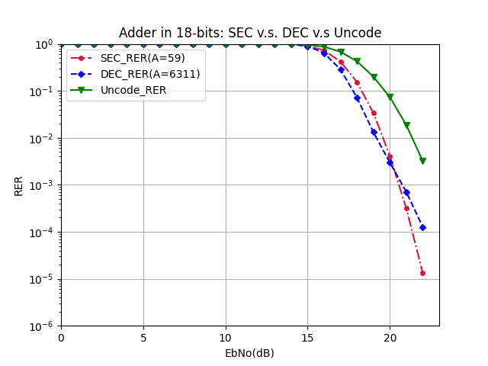
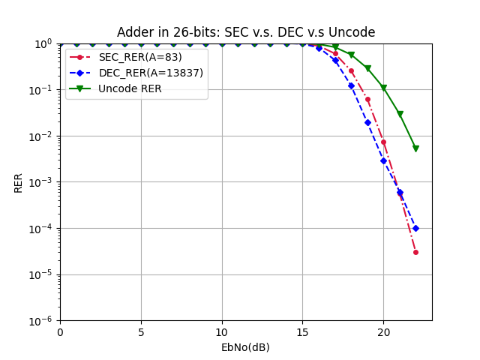
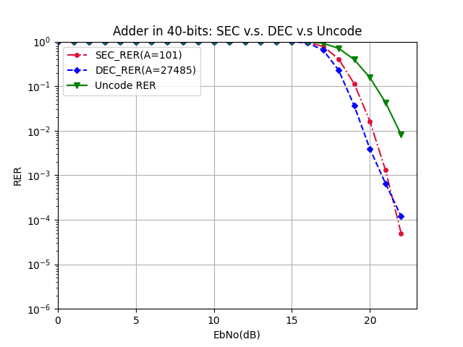
Experimental Results(6/11)
As the bit width increases, the code rate of the AN code decreases, resulting in a steeper curve slope. The curve approaches the ideal DEC curve more closely, and the performance of ANDEC improves accordingly.
20

Slide 21
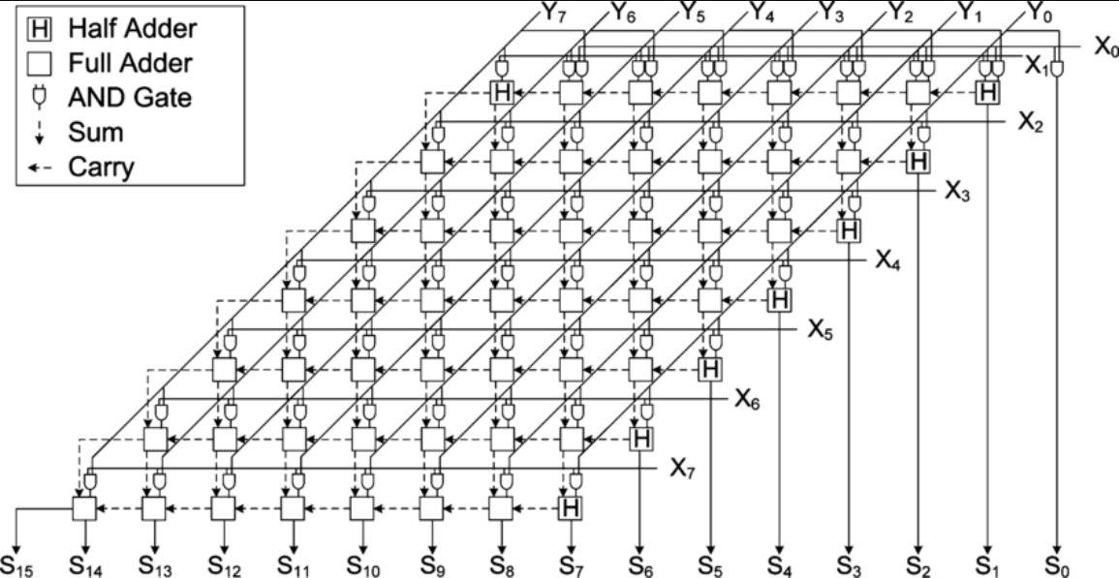
Experimental Results(7/11)
AWE Rate : Multiplier
Similar to an adder, noise is injected into each hardware logic gate or component.
If the noise causes a hardware fault, it results in a bit reversal at the output.
21

Slide 22
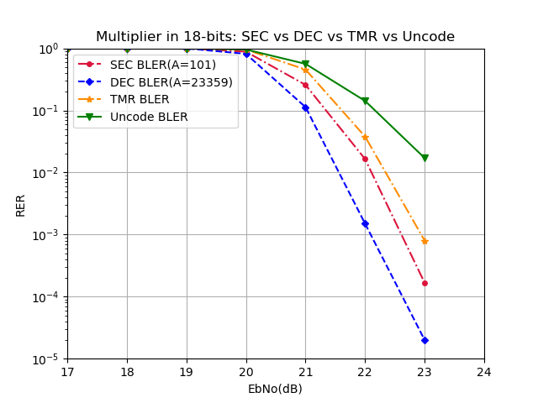
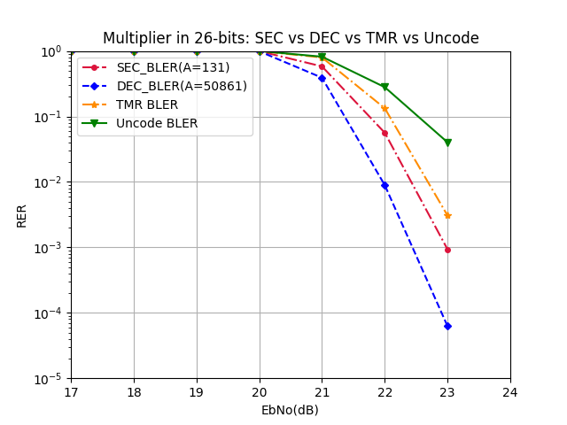
Experimental Results(8/11)
With decoder, SEC and DEC AN code are better than
TMR(Triple Modular Redundancy)
DEC is more reliable than others
22

Slide 23
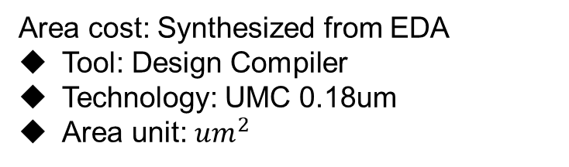
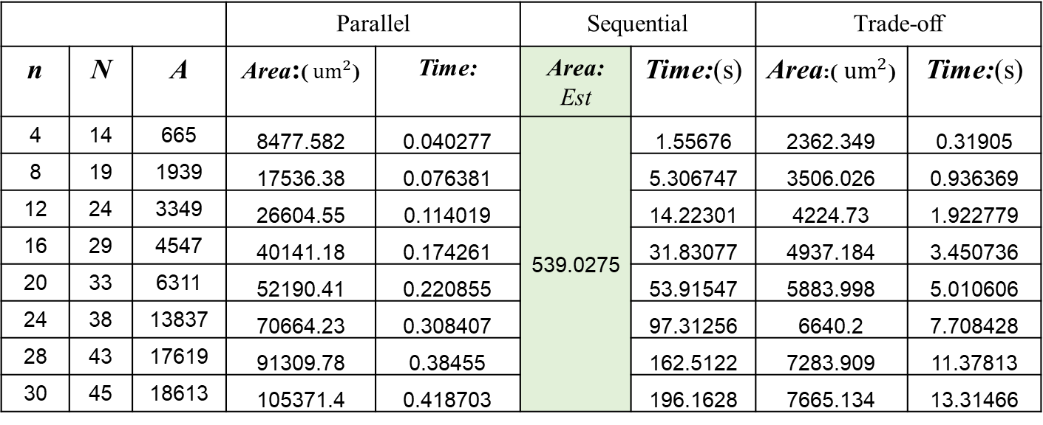
Experimental Results(9/11)
The cost of three method:
Area cost: Synthesized from EDA
Tool: Design Compiler
Technology: UMC 0.18um
Area unit: ${um}^{2}$
Time cost: Runtime from software
(in Zynq7000 Soc)
Tool: Python
Time unit: s
Assume: Total cost of Time and Area is a fixed value
 |  |  | Parallel |  | Sequential |  | Trade-off
n | N | A | Area:(${ um}^{2}$) | Time: | Area: Est | Time:(s) | Area:(${ um}^{2}$) | Time:(s)
4 | 14 | 665 | 8477.582 | 0.040277 | 539.0275 | 1.55676 | 2362.349 | 0.31905
8 | 19 | 1939 | 17536.38 | 0.076381 |  | 5.306747 | 3506.026 | 0.936369
12 | 24 | 3349 | 26604.55 | 0.114019 |  | 14.22301 | 4224.73 | 1.922779
16 | 29 | 4547 | 40141.18 | 0.174261 |  | 31.83077 | 4937.184 | 3.450736
20 | 33 | 6311 | 52190.41 | 0.220855 |  | 53.91547 | 5883.998 | 5.010606
24 | 38 | 13837 | 70664.23 | 0.308407 |  | 97.31256 | 6640.2 | 7.708428
28 | 43 | 17619 | 91309.78 | 0.38455 |  | 162.5122 | 7283.909 | 11.37813
30 | 45 | 18613 | 105371.4 | 0.418703 |  | 196.1628 | 7665.134 | 13.31466
23

Slide 24
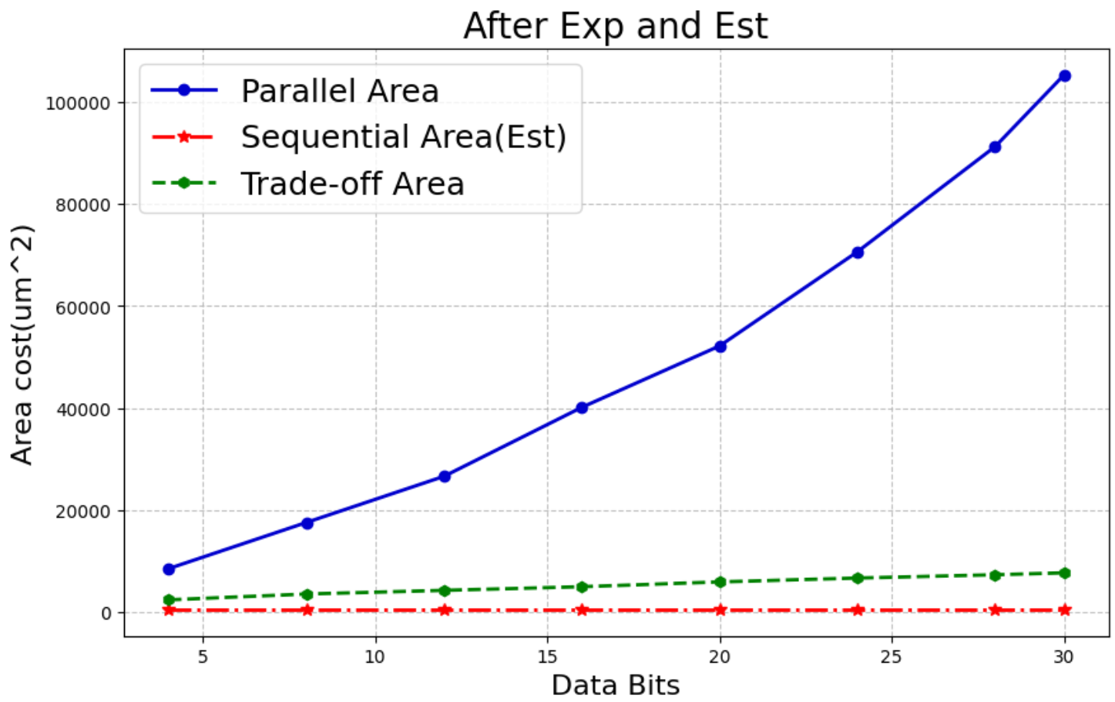
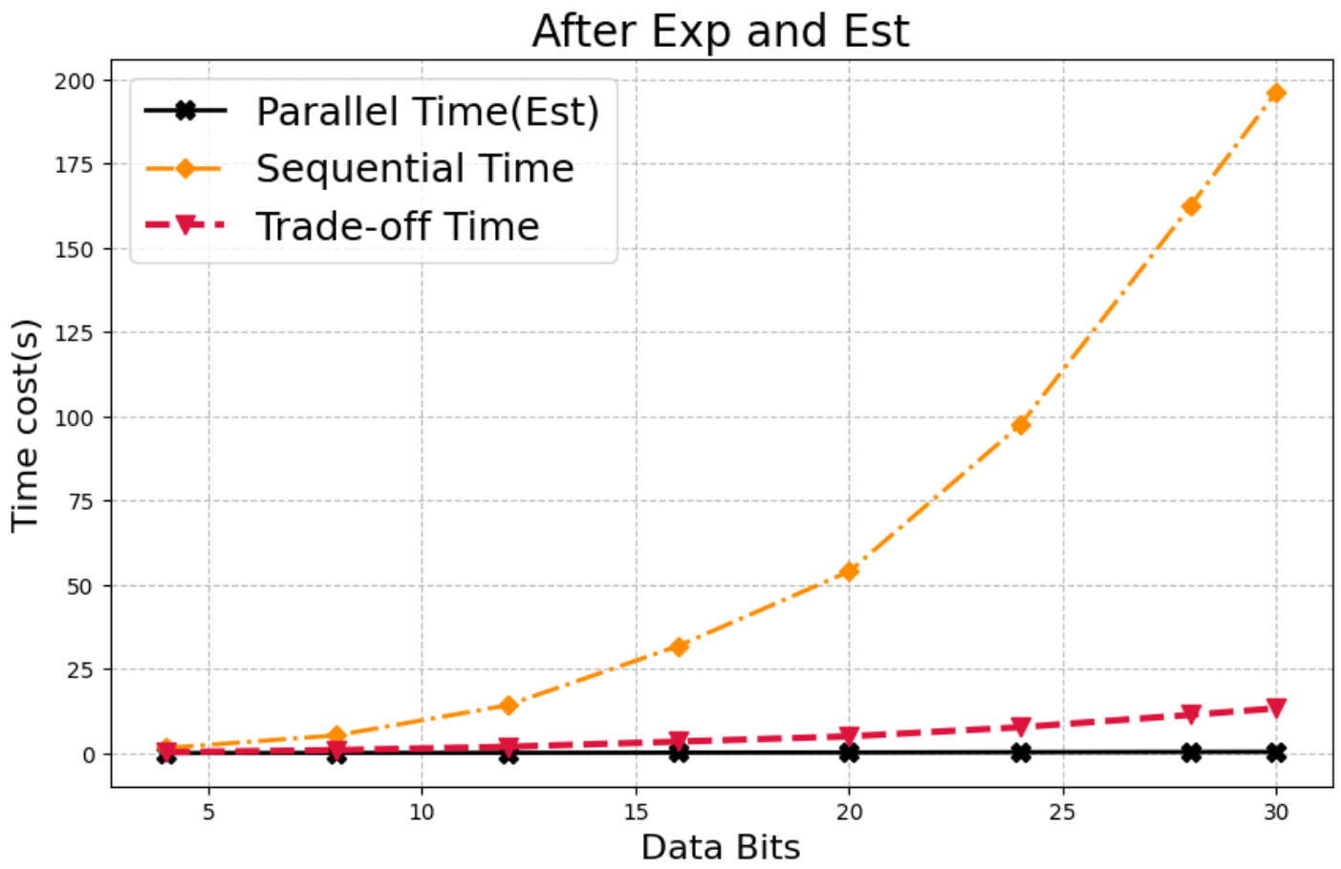
Experimental Results(10/11)
24

Slide 25
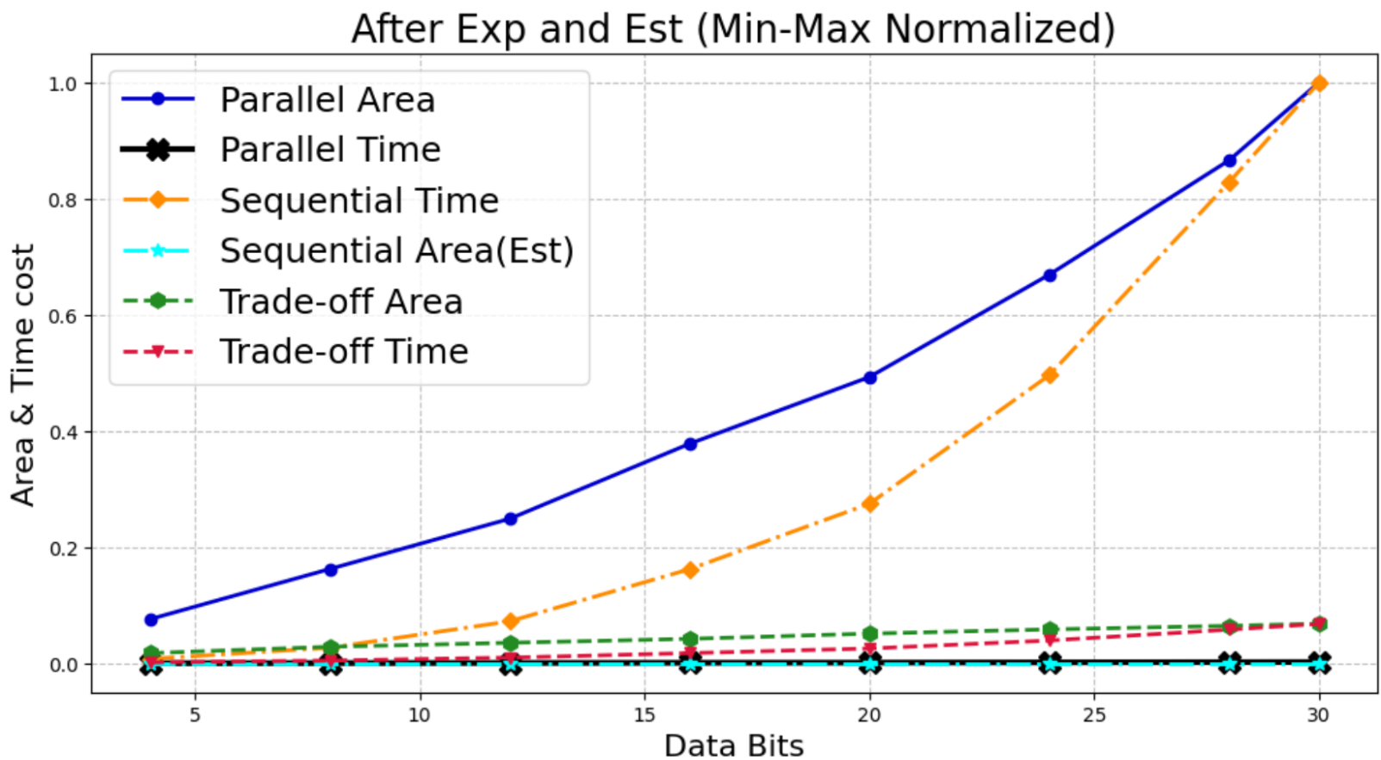
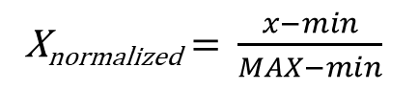
Experimental Results(11/11)
Using Min-MAX Normalization:
X_{normalized} = $\frac{x−min}{MAX−min}$
25

Slide 26
Conclusions and Future Work
Conclusions:
Although DEC does not show outstanding performance in channel transmission, it demonstrates superior fault tolerance when simulating hardware components such as adders and multipliers. Moreover, as the bit width increases, the value of A in DEC does not grow rapidly, and the code rate continues to decrease, indicating its suitability for large-integer computations, such as RSA.
From the area and time costs of the three methods, it can be observed that the Trade-off algorithm has the smallest cost increase as the bit width grows, making it the most efficient approach for implementing DEC.
Future Work:
Fully implement the trade-off algorithm in Verilog and complete the cell-based design flow.
Using Vivado BRAM to construct l-LUT and r-LUT.
Modulus BLER
26

Slide 27
Reference
[1] D. Boneh, et. al., "On the importance of checking cryptographic protocols for faults," in Advances in Cryptology - EUROCRYPT '97, Lecture Notes in CS, vol. 1233, Springer-Verlag, 1997, pp. 37–51.
[2] W. Stallings, "Cryptography and Network Security: Principles and Practice," 7th ed., Pearson, 2016.
[3] Y. Sun, et. al., "An area efficient modular arithmetic processor," 2003 5th Int’l Conf. on ASIC, Beijing, vol.2, pp. 1273-1276.
[4] R. Rivest, et. al., "A Method for Obtaining Digital Signatures and Public-Key Cryptosystems," Communications, ACM, 21(2), pp. 120–126, 1978.
[5] M. Joye and M. Tunstall,"Fault Analysis in Cryptography," Springer, 2012.
[6] J. M. Diamond, "Checking codes for digital computers," Proc. IRE, vol. 43, pp. 487-488, Apr. 1955.
[7] D. T. Brown, "Error detecting and error correcting binary codes for arithmetic operations," IRE Trans. Electron. Comput., vol. EC-9, pp. 333-337, Mar. 1960
[8] S. Lin and D. Costello. Error Control Coding: Fundamentals and Applications. Prentice-Hall, Englewood Cliffs, NJ, 2004.
[9] C.-D. Tsai, T.-Y. Chen, H.-W. Fu and T.-C. Huang. "TCBNN: Error-Correctable Ternary-Coded Binarized Neural Network," 2021 IEEE Int'l Conf. on AI Circuits and Systems (AICAS2021), virtual,June 7, 2021.
[10] C.-K. Liu. Error Correction Codes in Computer Arithmetic, technical report, University of Illinois at Urbana- Champaign, 1972.
27

Slide 28
Thank you for your patience~
28

